Slide 1
Ethical Implications of Geospatial Data and CoVID-19 Contact Tracing
Enbal Shacham, PhD
Michael Rozier, PhD, SJ
Jason Keune, MD, MBA, FACS

Slide 3
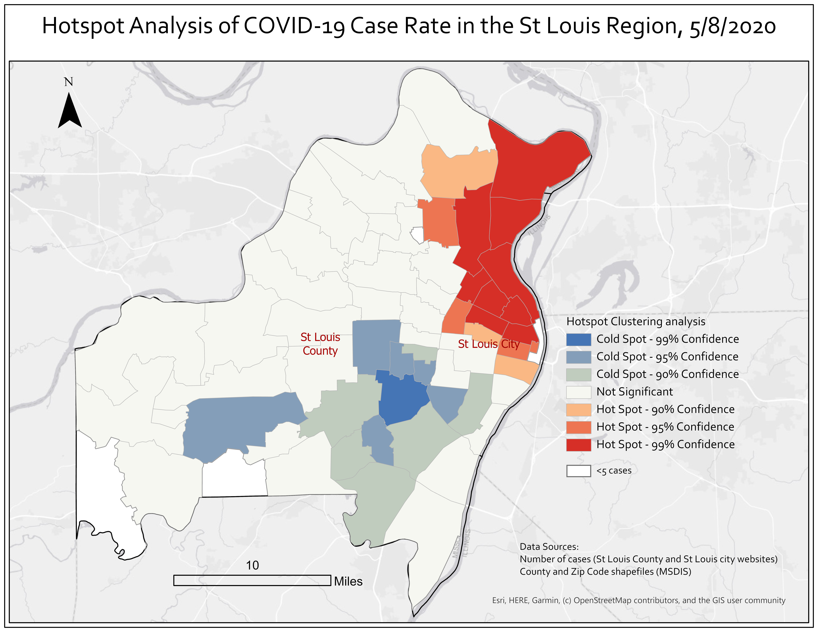

Slide 4
St. Louis Regional Movement Patterns During SARS-COV-2 Pandemic

Slide 7
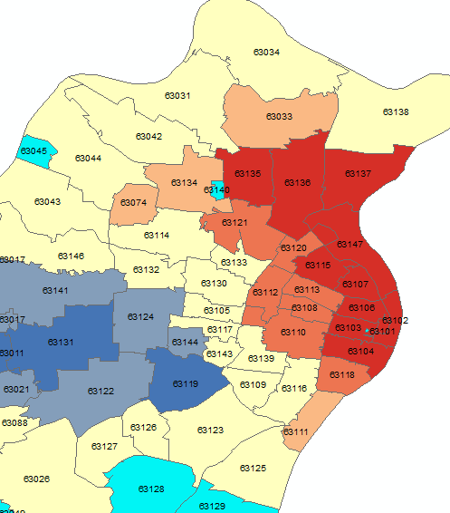
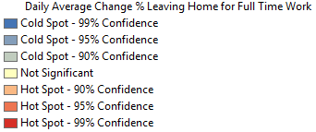
Daily Average Change in % Leaving for Full Time Work
Target zip code 63033 and 63136 had a significantly high change in daily % leaving home for full time work during stay at home orders.

Slide 8
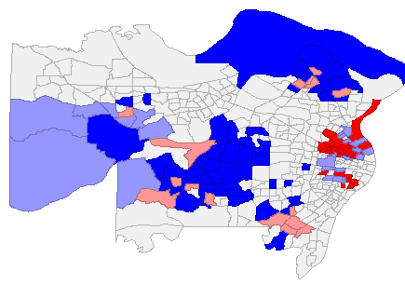
Food Service Employment and Work Travel During Social Distancing
Not significant
High % food employment, High % work travel
Low % food employment, Low % work travel
Low % food employment, High % work travel
High % food employment, Low % work travel

Slide 9
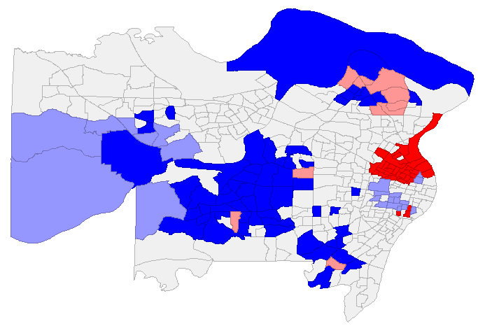
Health Support Employment and Work Travel During Social Distancing
Not significant
High % health employment, High % work travel
Low % health employment, Low % work travel
Low % health employment, High % work travel
High % health employment, Low % work travel

Slide 10
Likelihood of Work Travel During Social Distancing by Occupation
Employment category | Moran’s I | P-value | Interpretation
Food service | 0.21 | 0.001 | Tracts with higher % food service employment have higher % work travel
Health support | 0.31 | 0.001 | Tracts with higher % healthcare support employment have higher % work travel
Professional | -0.23 | 0.001 | Tracts with higher % professional employment have lower % work travel
Office admin | 0 | 0.35 | No association
Production/mfg | 0.12 | 0.001 | Tracts with higher % mfg employment have higher % work travel
Management | -0.24 | 0.001 | Tracts with higher % management employment have lower % work travel

Slide 11
For human subject research, informed consent requires several criteria be met. There is less consensus on what is required for other activities.
Disclosure of Information
Understanding
Voluntary Authorization
Competence

Slide 12
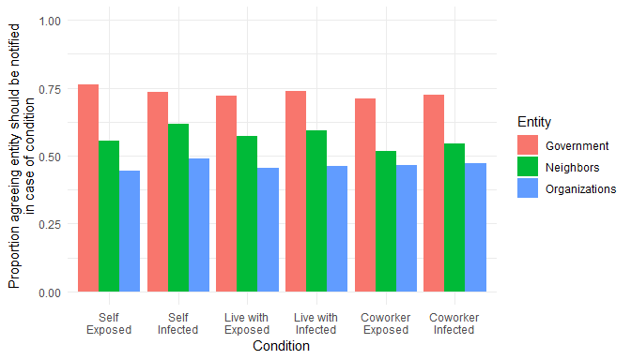
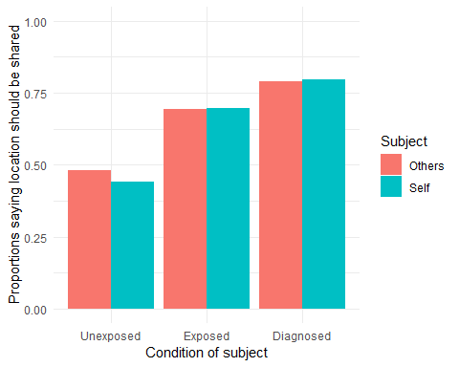
Most respondents trusted the government with their location data, especially for those diagnosed with COVID. There was no significant difference in opinion across demographic groups.
M Rozier, E Shacham, T Loux. March 12-14, 2020. Saint Louis University.

